Slide 1
Home Credit Default Prediction

Slide 2
Business Problem
Goal
Broaden financial inclusion by providing safe and positive borrowing experiences
Challenge
Ensure clients capable of repayment are not rejected
Use alternative data sources to assess repayment abilities more accurately
Desired outcomes
Increased loan approvals for creditworthy individuals
Reduced default rates
Expand access to fair and reliable loans for unbanked individuals

Slide 3
Objective
Machine Learning Pipeline
Decision-Making
Should We Approve Loan to this Client?
Default
ML
Model
New Client
Not Default
Notes:
The goal is to develop a predictive model to assess potential clients' default risks accurately, enabling them to approve more loan applications. The challenge lies in creating a model that not only predicts loan default effectively but also maintains stability over time, adapting to evolving client behaviors.

Slide 4
Dataset
In total, there are eight datasets, comprising one primary training set, one test set, and two auxiliary information tables.
The main features of the primary training set include personal attributes of users, such as gender, occupation, car ownership, home ownership, and the area of their residence, among other basic information.
The auxiliary information tables consist of users' historical application data and credit bureau recordsThese tables can be interconnected through specific keys.
We will be seeking to enhance the main train test dataset with the auxiliary, to do more feature selection and feature engineering to explore how they affect the main target.

Slide 5
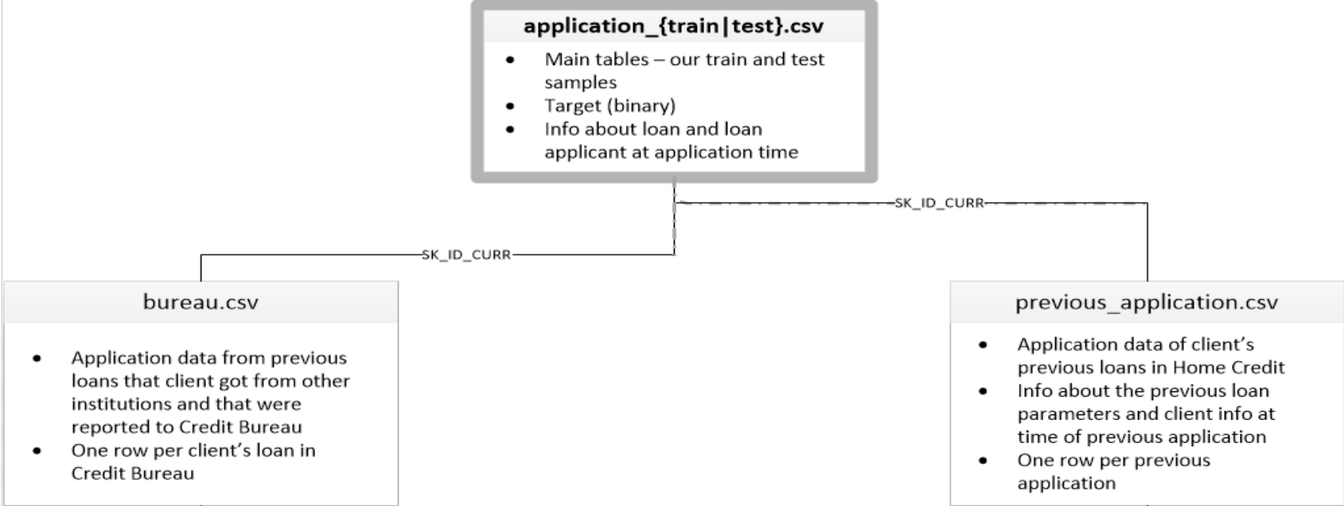

Slide 6
EDA - Train Dataset
Notes:
We first explored missing data, but as the missing information is important to the dataset

Slide 7
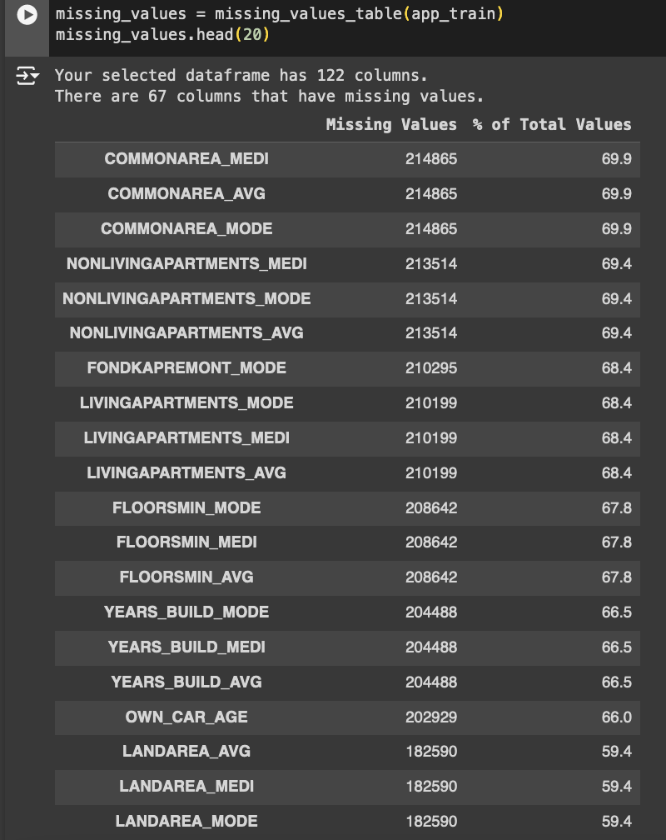
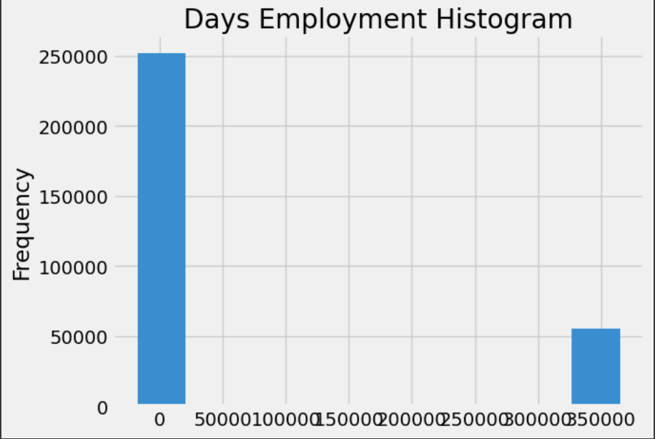
EDA - Missing Data Outlier
Notes:
We first explored missing data, but as the missing information is important to the dataset

Slide 8
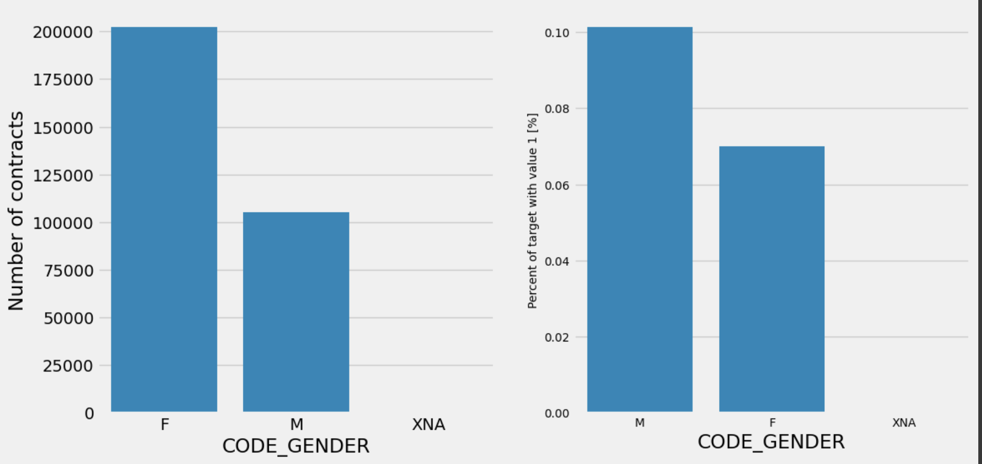
EDA - Gender

Slide 9
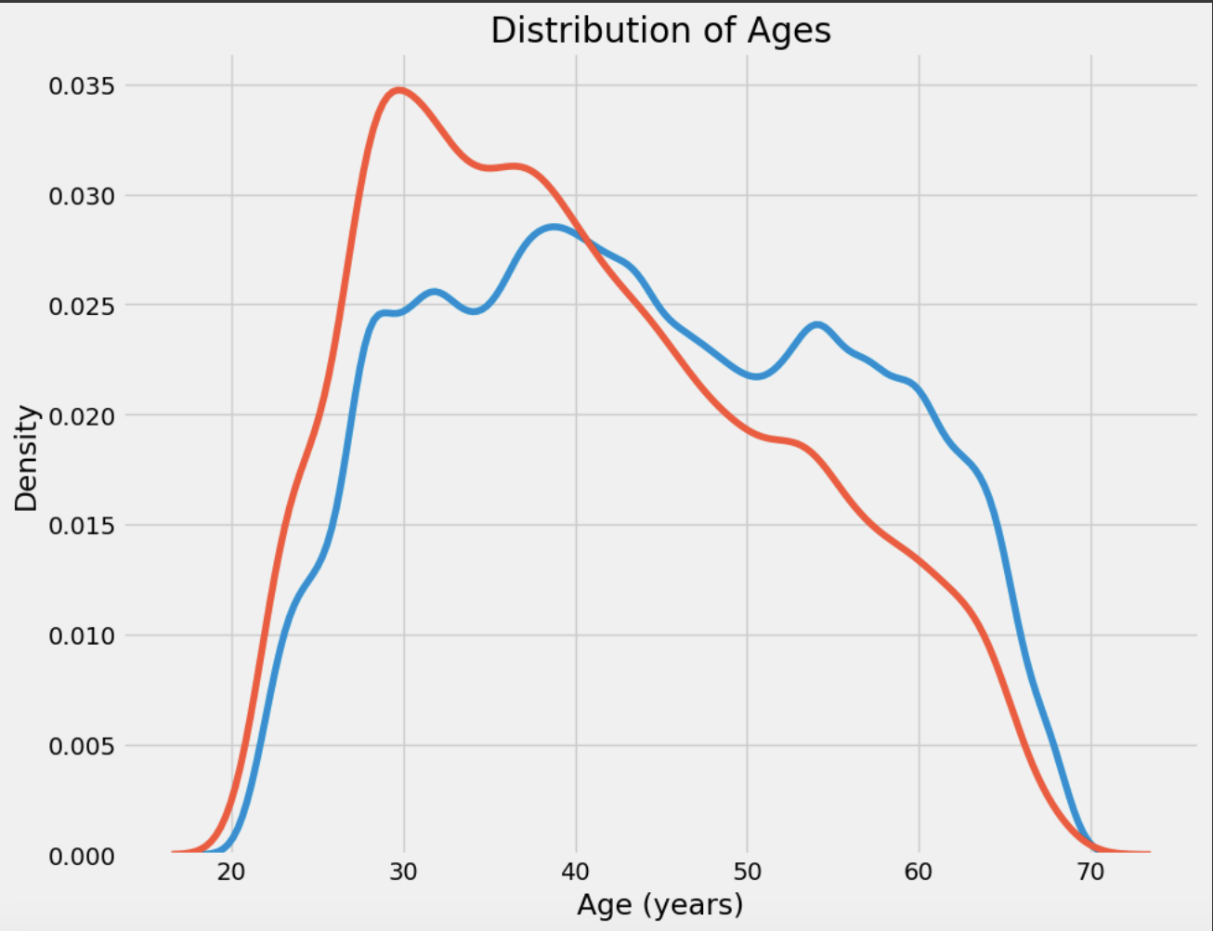
EDA - Distribution Ages

Slide 10
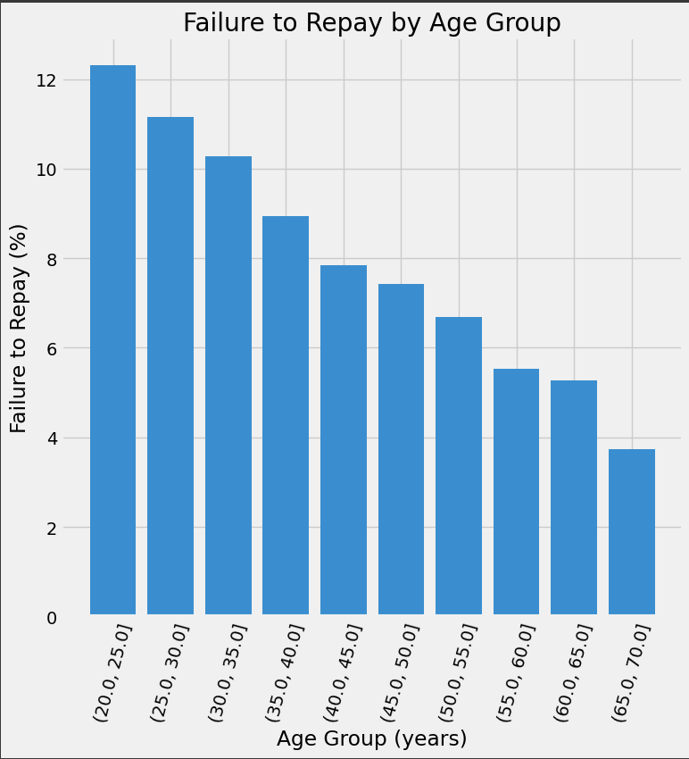
EDA - Failure to Pay / Age Group

Slide 11
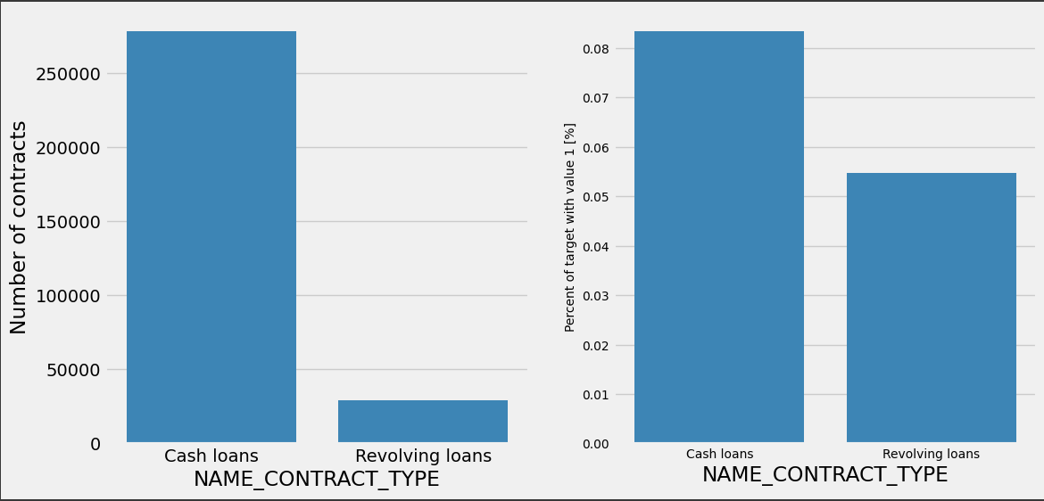
EDA - Outlier

Slide 12
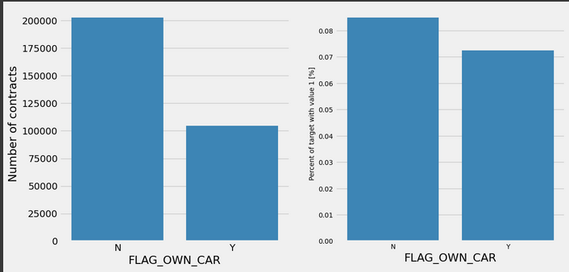
EDA - Outlier

Slide 13
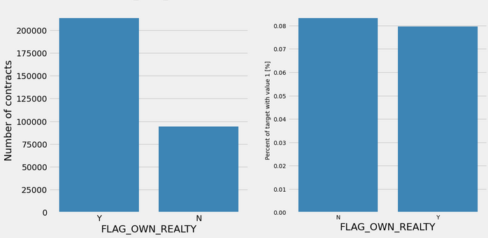
EDA - Outlier

Slide 14
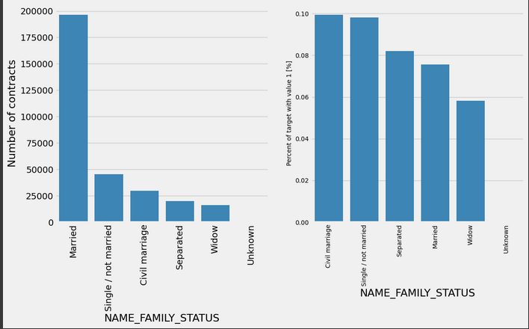
EDA - Outlier

Slide 15
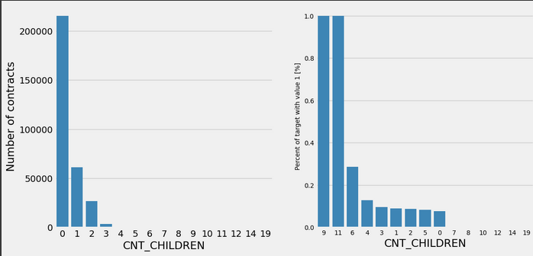
EDA - Outlier

Slide 16
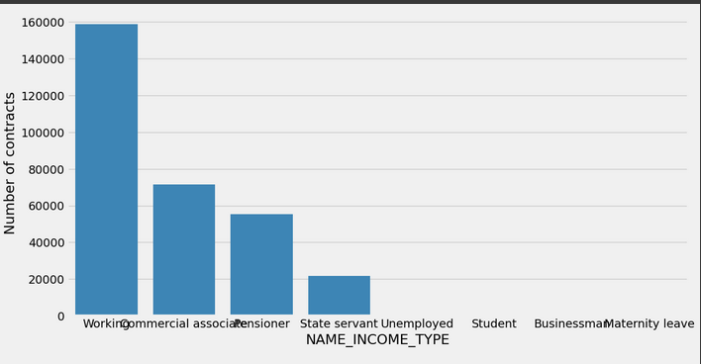
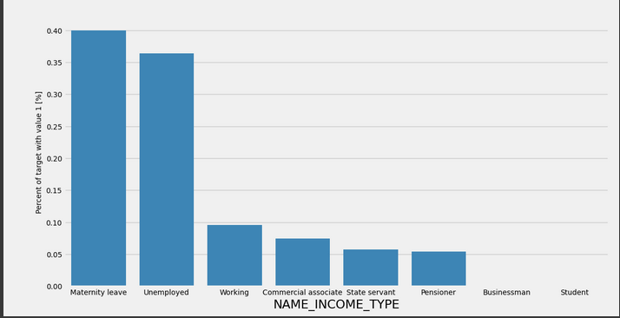
EDA - Outlier

Slide 17
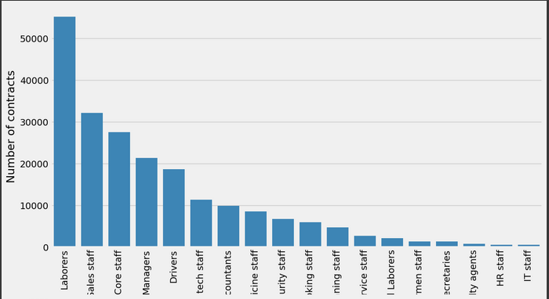
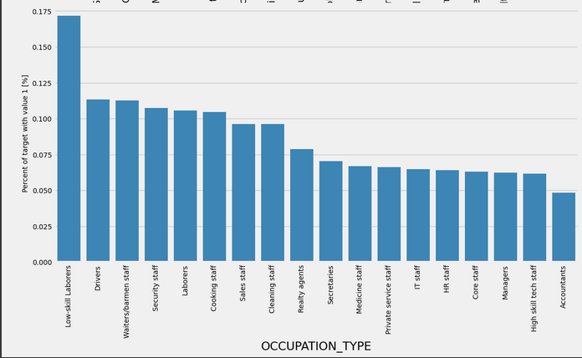
EDA - Outlier

Slide 18
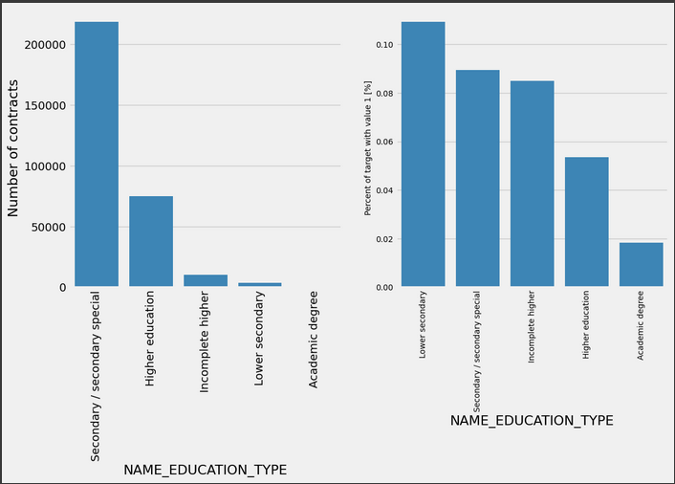
EDA - Outlier

Slide 19
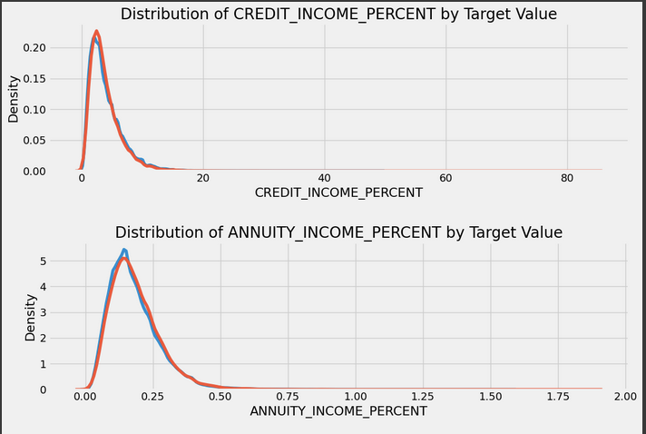
EDA - Distribution

Slide 20
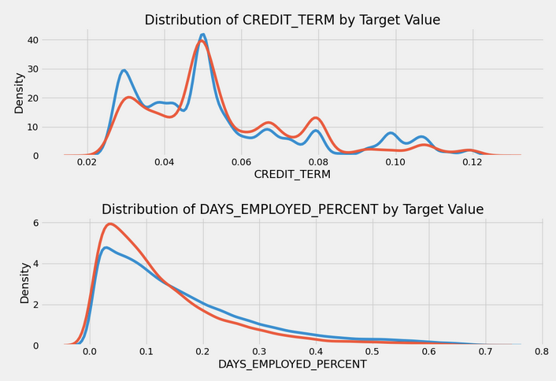
EDA - Distribution

Slide 21
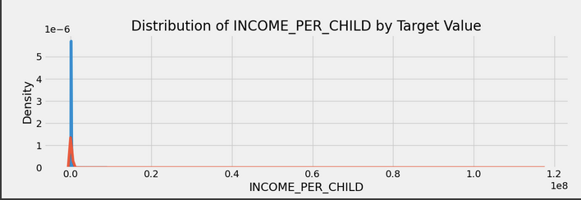
EDA - Distribution

Slide 22
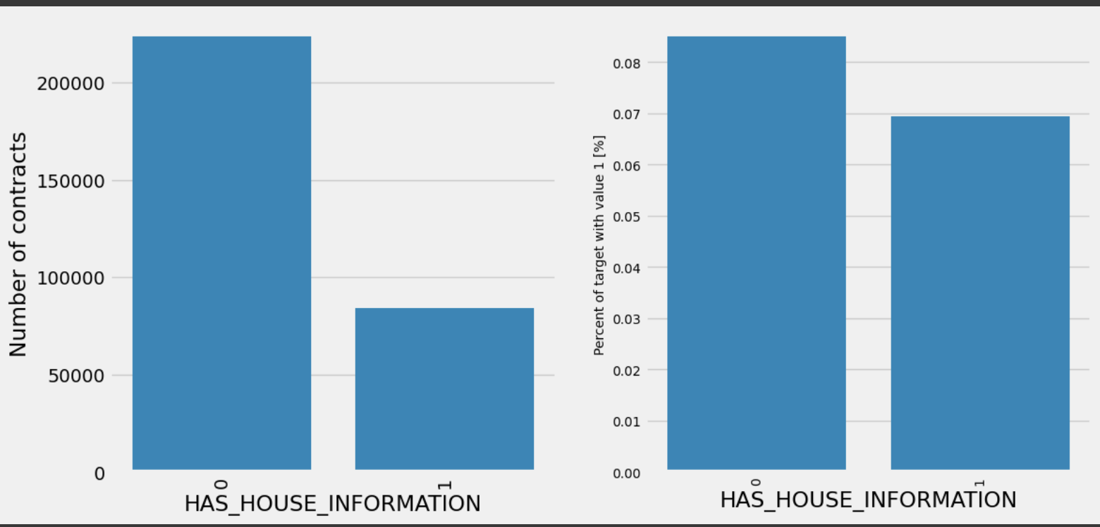
EDA - Has House

Slide 23
Data Preprocessing
Handling Missing Values in Modeling. LightGBM model's automatic handling of missing values.
Comparison with other models that require manual imputation strategies.
Handling Unrealistic Values in Data
Identification and treatment of unrealistic values, e.g., 365,243 in employment duration.
Hypothesis that such values may represent missing data, replaced with NaN.
Notes:
Handling Missing Values in Modeling
One of the strengths of LightGBM lies in its ability to automatically handle missing values during the training process. This feature eliminates the need for manual imputation steps, streamlining our workflow and preserving the integrity of our data.
In contrast, many traditional models require explicit handling of missing values through techniques like mean or median imputation. These methods involve replacing missing entries with statistical averages, such as the mean or median of the respective feature.
Handling Unrealistic Values in Data
During our data exploration, we encountered instances where reported values, such as 365,243 in employment duration, exceeded practical norms—far surpassing typical human lifespan. Recognizing these values as implausible, we investigated their origins and hypothesized that they might have been used to denote missing data.
To maintain data integrity and ensure accurate analysis, we systematically replaced these unrealistic values with NaN. This approach not only aligns with best practices in data cleaning but also mitigates potential biases that could arise from erroneous or anomalous entries.

Slide 24
Feature Engineering-Primary training set
New Feature Creation:
CREDIT_INCOME_PERCENT: Loan amount / Income
Higher ratio → Higher default risk
ANNUITY_INCOME_PERCENT: Annual repayment / Income
Higher ratio → Greater financial burden
CREDIT_TERM: Annual repayment / Loan amount
Shorter term → Higher default risk
DAYS_EMPLOYED_PERCENT: Employment days / Age
INCOME_PER_CHILD: Income / Number of children
Larger families → Higher financial strain
HAS_HOUSE_INFORMATION: Binary for missing housing info (0: missing, 1: present)
Missing data → Higher default risk
Distribution Analysis:
Minimal differentiation between defaulters and non-defaulters for most features
CREDIT_TERM shows more noticeable differences
Visual separation low initially; effectiveness assessed in the model
Notes:
New Feature Creation: We created several new features:
CREDIT_INCOME_PERCENT: Loan amount divided by income; higher ratios may indicate a higher risk of default.
ANNUITY_INCOME_PERCENT: Annual repayment divided by income; higher ratios suggest a greater financial burden.
CREDIT_TERM: Annual repayment divided by loan amount; shorter terms may increase default risk.
DAYS_EMPLOYED_PERCENT: Employment days divided by age.
INCOME_PER_CHILD: Income divided by the number of children; larger families may experience higher financial strain.
HAS_HOUSE_INFORMATION: Binary feature indicating if housing info is missing; missing data might correlate with higher default risk.
Distribution Analysis: We examined the distribution of these features among defaulters and non-defaulters. Most features showed minimal differentiation, except for CREDIT_TERM, which showed more noticeable differences. Initial visual separation might be low, but the effectiveness of these features can be better evaluated within the model.

Slide 25
Feature Engineering-Auxiliary training set
Data Sources:
Main Dataset
Auxiliary Datasets: Credit Bureau, Previous Applications
Feature Creation:
Continuous variables: Aggregated stats (mean, max, etc.)
Categorical variables: Frequency and dummy variables
Integration:
Merging features into the main dataset
Feature Selection:
Correlation analysis to remove features with >0.8 correlation
Key Points:
Integration of Auxiliary Data: Utilizing SK_ID_CURR to link and extract features from credit bureau and previous loan applications.
Statistical Feature Generation: Aggregating loan amounts and calculating frequencies of loan types.
Dimensionality Reduction: Employing correlation thresholds to streamline the feature set, enhancing model performance.
Notes:
In addition to the primary training and prediction datasets, auxiliary datasets are often used, which can be linked to the main dataset using the common key "SK_ID_CURR." Each row in the credit bureau dataset represents loan applications made by individuals at different financial institutions. Since "SK_ID_CURR" can link to multiple "SK_ID_BUREAU" entries, representing multiple loans per applicant, direct merging is not feasible. Instead, we aggregate auxiliary data using statistical methods (like groupby) to avoid duplicate records and ensure each applicant is represented uniquely in the training set.
We meticulously generate features from these datasets. For continuous variables, this involves computing aggregated statistics such as the mean, maximum, and median loan amounts. For categorical variables, we transform them into dummy variables and calculate their occurrence frequencies, which provide insights into the applicant's financial behaviors.
However, adding numerous features can lead to complexity and redundancy. To address this, we conduct a thorough correlation analysis, setting a stringent threshold of 0.8. This allows us to remove highly correlated features, reducing dimensionality and focusing on the most impactful variables.

Slide 26
Models
Proposed, but not used:
Linear Regression
ResNet
Self Built CNN
Final Models:
Logistic Regression
KNN
SVM
XGBoost
TabNetClassifier
LGBM
​Model Evaluation Methods:
ROC-AUC Score for evaluating class differentiation.

Slide 27
Logistic Regression
A logistic regression model is a statistical method used for binary classification that estimates the probability of a binary outcome using a logistic function applied to a linear combination of input features.
Parameters
C': [0.01, 0.1, 1, 10] Regularization parameter controlling the trade-off between training and testing error
'penalty': ['l1', 'l2'] The type of regularization to be applied
'solver': ['liblinear', 'lbfgs', 'saga', 'newton-cg', 'sag'] The algorithm used for optimization
'max_iter': [100, 200, 300, 500, 1000, 10000] Maximum iterations to run
'class_weight': [None, 'balanced'] Weights classes: pays more attention to underrepresented classes.
Performance
Train AUC: 0.7676
Val AUC: 0.7642

Slide 28
KNN
KNN is an instance-based learning algorithm. Instead of creating a general model for the data, it stores the training instances and makes predictions using these stored instances. The prediction for a new instance is determined based on the similarity (usually measured by distance) to the known instances.
Major Parameters
classifier__n_neighbors = [3, 5, 7, 10] → Number of nearest neighbors used
classifier__weights = ['uniform', 'distance'] → Weighting type for neighbor influence
classifier__metric = ['euclidean', 'manhattan', 'minkowski'] → Distance metric for neighbor calculation
Performance
Train AUC: 0.910861
Val AUC: 0.756258

Slide 29
SVM
Advantages
SVM is particularly effective when the number of dimensions exceeds the number of samples.
Especially in high-dimensional space, by using regularization parameters, SVMs can prevent overfitting.
SVM can handle non-linear data efficiently by using the kernel trick to transform the input space.
Parameters
C = [0.1, 1, 10, 100] → Regularization parameter controlling the trade-off between training and testing error
kernal = ['linear', 'poly', 'rbf', 'sigmoid'] → Specifies the type of kernel function to transform the input data into the required form.
degree = [2, 3, 4]→ Degree of the polynomial kernel function, relevant only when the kernel is 'poly'; ignored for other kernel types.
gamma = ['scale', 'auto']→ Kernel coefficient for 'rbf', 'poly', and 'sigmoid', determining the influence of a single training example (scale or auto).
Performance
Train AUC: 0.9831
Val AUC: 0.6271
Notes:
Firstly, let's look at the advantages of SVM:
High-Dimensional Effectiveness: SVM is particularly effective when the number of dimensions exceeds the number of samples, making it highly suitable for datasets with many features.
Overfitting Prevention: Especially in high-dimensional spaces, SVMs can prevent overfitting by using regularization parameters, ensuring that the model generalizes well to new data.
Kernel Trick Versatility: SVM can handle non-linear data efficiently by using the kernel trick, which transforms the input space into higher dimensions where a linear separation is possible.
Parameters: Next, let's review the key parameters used in tuning our SVM model:
C = [0.1, 1, 10, 100]: This is the regularization parameter that controls the trade-off between achieving a low training error and a low testing error, helping to prevent overfitting.
kernel = ['linear', 'poly', 'rbf', 'sigmoid']: This parameter specifies the type of kernel function to transform the input data into the required form, enabling the SVM to handle different types of data relationships.
degree = [2, 3, 4]: This is the degree of the polynomial kernel function, relevant only when the kernel is set to 'poly'; it is ignored for other kernel types.
gamma = ['scale', 'auto']: This parameter is the kernel coefficient for 'rbf', 'poly', and 'sigmoid' kernels, determining the influence of a single training example and affecting the shape of the decision boundary.
Performance: Finally, let's discuss the performance results of our trained SVM model:
Train AUC: 0.9831: This high area under the curve (AUC) score on the training set indicates that our model performs exceptionally well in distinguishing between classes on the training data.
Val AUC: 0.6271: The validation AUC score is lower, suggesting that while the model performs well on the training data, it may be overfitting and not generalizing as well to unseen data.
Conclusion: In conclusion, SVMs offer significant advantages in handling high-dimensional data and preventing overfitting through proper regularization. By tuning key parameters like C, kernel type, degree, and gamma, we can optimize the model's performance. Although our model shows excellent training performance, the lower validation AUC highlights the need for further tuning or additional techniques to improve generalization.

Slide 30
XGBoost
Advantages
XGBoost quickly handles large datasets, ideal for fraud detection.
Natively handles missing data, suitable for real-world datasets
Cross-validation and early stopping ensure maximum predictive accuracy
Parameters
n_estimators = 1000 → Number of boosting rounds (trees)
learning_rate = 0.05 → Learning rate (shrinkage)
max_depth = 6 → Maximum depth of each tree
subsample = 0.8 → Subsample ratio of the training instances
colsample_bytree = 0.8 → Subsample ratio of columns when constructing each tree
reg_alpha = 0.1 → L1 regularization term on weights (alpha)
reg_lambda = 0.1 → L2 regularization term on weights (lambda)
n_jobs = -1 → Number of parallel threads used to run XGBoost
early_stopping_rounds = 100 → Number of rounds without improvement to stop training.
verbose = 200 → Verbosity of printing information during training.
n_folds = 5 → Number of folds for cross-validation.
drop columns = ['SK_ID_CURR', 'TARGET'] → Columns to be dropped from training data
Performance
Train AUC: 0.910861
Val AUC: 0.756258
Notes:
XGBoost is an excellent choice for fraud detection due to its efficiency and scalability, allowing it to quickly process large datasets typical in this field. It employs robust regularization techniques that reduce overfitting, enhancing the model's ability to generalize and accurately identify fraudulent activities. Additionally, XGBoost natively handles missing data, making it resilient to the incomplete information often found in real-world datasets. Features like cross-validation and early stopping further ensure the model is well-tuned for optimal predictive accuracy, making XGBoost a powerful tool for detecting fraud.
n_estimators = 1000 → Number of boosting rounds (trees)
learning_rate = 0.05 → Learning rate (shrinkage)
max_depth = 6 → Maximum depth of each tree
subsample = 0.8 → Subsample ratio of the training instances
colsample_bytree = 0.8 → Subsample ratio of columns when constructing each tree
reg_alpha = 0.1 → L1 regularization term on weights (alpha)
reg_lambda = 0.1 → L2 regularization term on weights (lambda)
n_jobs = -1 → Number of parallel threads used to run XGBoost
early_stopping_rounds = 100 → Number of rounds without improvement to stop training.
verbose = 200 → Verbosity of printing information during training.
n_folds = 5 → Number of folds for cross-validation.
drop columns = ['SK_ID_CURR', 'TARGET'] → Columns to be dropped from training data

Slide 31

TabNetClassifier
Advantages
A deep learning model specifically designed for tabular data
Uses decision layers and attention mechanisms to dynamically select features
Supports supervised learning, applicable for classification and regression tasks
Parameters
n_d = 16 → Dimension of decision prediction layer
n_a = 8 → Dimension of attention embedding
n_steps = 3 → Number of steps in architecture
Gamma = 1.0 → Relaxation parameter in sparsemax
Lambda_sparse = 0.01 → Coefficient for sparsity regularization
Performance
Train AUC: 0.767389
Validation AUC: 0.743730
Notes:
The TabNetClassifier is developed by researchers at Google Cloud. It combines the clarity of decision tree models with the power of deep learning. It is also designed for tabular data, which is data structured in rows and columns, similar to spreadsheets or database tables. Since the dataset we are working on this time has each row representing a case and each column representing different features, we believe it’s ideal to go for it.
n_d = 16 → Controls the number of features used at decision steps
n_a = 8 → #Determines the size of the attention embedding
n_steps = 3 → #Defines the number of decision steps
Gamma = 1.0 → Adjusts the entropy of the output distribution
Lambda_sparse = 0.01 → Encourages sparsity in feature selection
High performance, interpretability and dynamic feature selection

Slide 32
LGBM
LightGBM (Light Gradient Boosting Machine) is a highly efficient gradient boosting framework developed by Microsoft, known for its speed and performance, particularly with large datasets. It utilizes a leaf-wise growth strategy for decision trees, which allows for deeper tree growth and generally results in better performance on imbalanced data sets. Additionally, LightGBM supports handling categorical features directly and offers advanced features like gradient-based one-side sampling and exclusive feature bundling to reduce memory usage and improve computation speed.
Major Parameters
Encoding Method = Default → 'ohe' Alternatives → 'le'
n_estimators = 1000 → Number of boosting rounds.
objective = 'binary' → Specifies that the task is binary classification.
class_weight = 'balanced' → Weights classes: pays more attention to underrepresented classes.
learning_rate = 0.05 → Step size shrinkage used to prevent overfitting.
reg_alpha = 0.1 → L1 regularization term on weights.
reg_lambda = 0.1 → L2 regularization term on weights.
subsample = 0.8 → Subsample ratio of the training instance.
Performance
Train AUC: 0.807956
Val AUC: 0.765970

Slide 33
Model Comparison Chart
Model | Train AUC | Val AUC
Logistic | 0.7676 | 0.7642
KNN | 0.9108 | 0.7562
SVM | 0.9831 | 0.6271
XGBoost | 0.9108 | 0.7562
TabNetClassifier | 0.7673 | 0.7437
LGBM | 0.8079 | 0.7659

Slide 34
Future Considerations/Next Steps
Data
Model
Collect and combine multiple related datasets
Create new features
Explore additional feature engineering techniques
Feature selection
Experiment with more models
Utilize pre-trained models on similar tasks
Hyperparameter tuning
Notes:
Data
Collect and integrate multiple related datasets:
Use external financial datasets to enrich the training data.
Create new features:
Develop features based on domain knowledge (e.g., income stability, debt-to-income ratio). / capture complex relationships by aggregation, division and subtraction ex. credit_annuity_ratio: AMT_CREDIT / AMT_ANNUITY
Explore additional feature engineering techniques:
Apply clustering to identify segments within the data.
Use dimensionality reduction methods like PCA to simplify the feature space..
Feature selection:
Employ techniques like Recursive Feature Elimination (RFE)
Utilize regularization methods (e.g., Lasso) to eliminate less important features.
Model
Utilize pre-trained models on similar tasks:
Fine-tune models pre-trained on similar financial datasets.
Apply transfer learning to leverage knowledge from related tasks.
Hyperparameter tuning:
Conduct Grid Search or Random Search for hyperparameter optimization.
Use Bayesian Optimization for efficient hyperparameter tuning.

Slide 35
Next Steps
Get hands dirty

